Slide 1
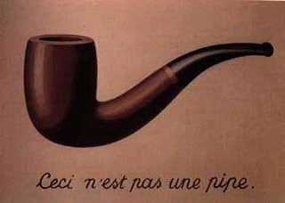
CMN 1160A – Introduction to Media Studies
Week 5A: Theoretical Perspectives on Media Content
Daniel J. Paré
University of Ottawa, Department of Communication
October 4, 2016
Notes:
1

Slide 2
Preview
Post-Structuralism
Communication and Social Theory
Hall
Notes:
2
2

Slide 3
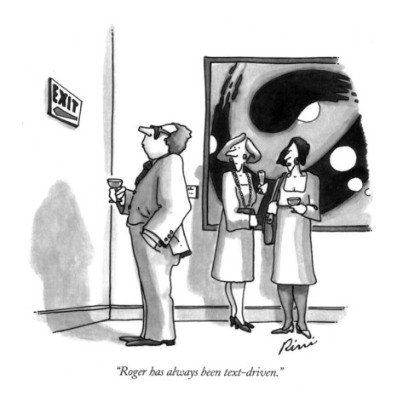
Studying Content
Post - Structuralism
Meaning comes from the decoder
Meaning is never fixed - changes from reader to reader
There is no single ‘true’ meaning to a text - Auteur theory is only one window on the reality of the text
Intertextuality

Slide 4
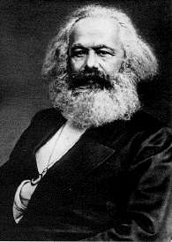
Communication Theory as Social Theory
Philosophers have hitherto only interpreted the world in various ways; the point is to change it.
- Karl Marx (1845). Theses On Feuerbach
Notes:
4

Slide 5
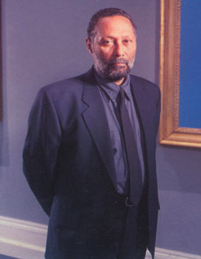
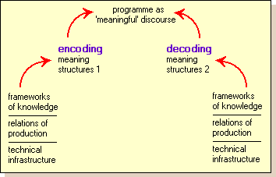
Stuart Hall – Encoding/Decoding Model

Slide 6
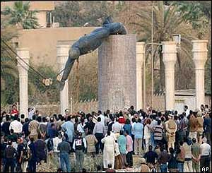

Slide 7



Three Interpretative Positions
Dominant (or 'hegemonic') reading
Negotiated reading
Oppositional (or ‘counter-hegemonic’) reading

Slide 8
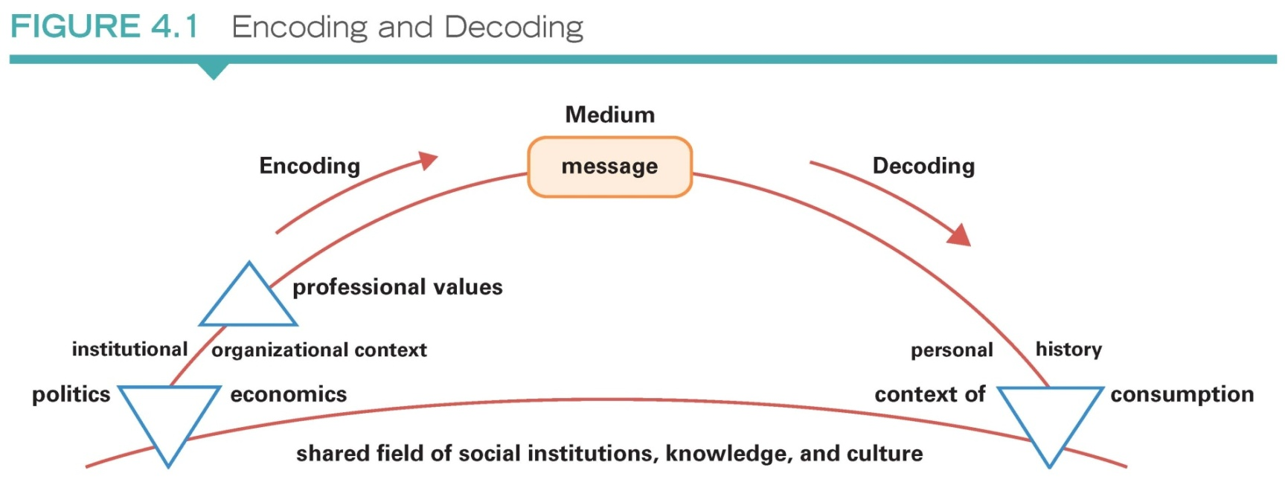
Notes:
8

Slide 9
Structure and Agency
STRUCTURE:
Institutions, such as religion, the state, and the economy, and factors such as sex, gender, age, class, nationality, ethnicity, etc., which influence the opportunities that individuals have.
AGENCY:
The capacity of individuals to act independently and make free choices.
THE ISSUE:
Are we free to choose how to think, believe, act, and behave, or do structural forces dominate us?
Social Practice
Structure
Action
Notes:
9

Slide 10

Theories of the Media – Society Relations
Libertarian Theory
Social Responsibility Theory
The Mass Society Thesis
Political Economy and Marx

Slide 11

Analyzing Content
Discourse Analysis
Examines language and the perspective or ‘position’ it gives us in the social world
Content Analysis
Examines the characteristics of media content, especially quantitative aspects
Genres / Media forms

Slide 12



Slide 13

Rationale for analyzing content?
Allows us to see what is hidden in texts.
Gives us an understanding of the polysemy of communication.
Reveals just how much of culture we take for granted as natural and necessary.
Unifies the study of communication, and makes legitimate the study of things like pop-culture
Notes:
13

Slide 14

Advertising’s Image of Women
Objectification – equating women with objects
Irrelevant sexualization
Infanticization – women as silly, childish, vulnerable, vapid
Domestication – women as homebodies, slaves to husbands and children

